Slide 1
Routing Security – What it matters
26 - 28 August 2019
SAFNOG 5
Michuki Mwangi
Regional Development Manager for Africa
Mwangi@isoc.org

Slide 2
Background
There are 64,420 networks (Autonomous Systems) connected to Internet, each using a unique Autonomous System Number (ASN) to identify itself
~10,000 multi-homed ASes – networks connected to >=2 other networks
Routers use Border Gateway Protocol (BGP) to exchange “reachability information” - networks they know how to reach
Routers build a “routing table” and pick the best route when sending a packet, typically based on the shortest path

Slide 3

The Routing Problem
Caption 10/12pt
Caption body copy
Border Gateway Protocol (BGP) is based entirely on trust between networks
No built-in validation that updates are legitimate
The chain of trust spans continents
Lack of reliable resource data
The routing system is under attack!

Slide 4
How big is the problem?
Some Facts & Figures

Slide 5
Routing Incidents Cause Real World Problems
Event | Explanation | Repercussions | Example
Prefix/Route Hijacking | A network operator or attacker impersonates another network operator, pretending that a server or network is their client. | Packets are forwarded to the wrong place, and can cause Denial of Service (DoS) attacks or traffic interception. | The 2008 YouTube hijack April 2018 Amazon Route 53 hijack
Route Leak | A network operator with multiple upstream providers (often due to accidental misconfiguration) announces to one upstream provider that is has a route to a destination through the other upstream provider. | Can be used for a MITM, including traffic inspection, modification and reconnaissance. | September 2014. VolumeDrive began announcing to Atrato nearly all the BGP routes it learned from Cogent causing disruptions to traffic in places as far-flung from the USA as Pakistan and Bulgaria.
IP Address Spoofing | Someone creates IP packets with a false source IP address to hide the identity of the sender or to impersonate another computing system. | The root cause of reflection DDoS attacks | March 1, 2018. Memcached 1.3Tb/s reflection-amplification attack reported by Akamai
Notes:
This is a summary of the following three slides. (Depending on the audience, you can use this one slide, OR the other three, and don’t need all four slides.)

Slide 6
The routing system is constantly under attack
13,935 total incidents (either outages or attacks like route leaks and hijacks)
Over 10% of all Autonomous Systems on the Internet were affected
3,106 Autonomous Systems were a victim of at least one routing incident
1,546 networks were responsible for 5304 routing incidents
547 networks were responsible for 1576 routing incidents
Source: https://www.bgpstream.com/

Slide 7
No Day Without an Incident
http://bgpstream.com/

Slide 8
Why it matters for Africa

Slide 9
The evolving landscape
CDN | ASN | NAPAfrica | JINX | IXPN Lagos
Akamai | 20940 | Yes | No | No
Amazon | 16509 | No | No | No
Cloudflare | 13335 | Yes | Yes | Yes
Facebook | 32934 | Yes | No | Yes
Google | 15169 | Yes | Yes | Yes
Netflix | 2906 | Yes | No | No
Twitter | 13414 | No | No | No
More large CDNs are connected (peering) in Africa – errors can have a global effect - How a Nigerian ISP Accidentally Knocked Google Offline
Larger percentage of ISP traffic is via IXP;
Some ISPs may not have sufficient transit capacity
Unnecessary incidents constrain the limited IXP technical support resources
Overall, incidents affect your customers.
NB: ASNs visible at IXP Route-Servers

Slide 10
Mutually Agreed Norms for Routing Security (MANRS)
Provides crucial fixes to eliminate the most common threats in the global routing system
Brings together established industry best practices
Based on collaboration among participants and shared responsibility for the Internet infrastructure

Slide 11
MANRS Actions
Filtering Prevent propagation of incorrect routing information
Ensure the correctness of your own announcements and announcements from your customers to adjacent networks with prefix and AS-path granularity
Anti-spoofing Prevent traffic with spoofed source IP addresses
Enable source address validation for at least single-homed stub customer networks, their own end-users, and infrastructure
Coordination Facilitate global operational communication and coordination between network operators
Maintain globally accessible up-to-date contact information in common routing databases
Global Validation Facilitate validation of routing information on a global scale
Publish your data, so others can validate

Slide 12
Everyone benefits from improved Routing Security
Joining MANRS means joining a community of security-minded network operators committed to making the global routing infrastructure more robust and secure.
Heads off routing incidents, helping networks readily identify and address problems with customers or peers.
Consistent MANRS adoption yields steady improvement, but we need more networks to implement the actions and more customers to demand routing security best practices.
The more network operators apply MANRS actions, the fewer incidents there will be, and the less damage they can do.

Slide 13
MANRS Participants – as of July 2019
196 Network Operators
322 Autonomous Systems (ASNs)
33 Internet Exchange Points
10 partners (promotion, capacity building etc..)

Slide 14
MANRS Participants in Africa
1775 ASNs assigned to Africa
5 ASNs participating in MANRS for Network Operators
SEACOM (AS37100) - 4 actions
WorkOnline (AS37271) - 4 actions
Orange Morocco (AS36925) - 4 actions
MORENET (AS327700) - 4 actions
iWay Africa (AS36915) - 4 actions
2 IXPs participating in MANRS for IXPs
RINEX
NAPAfrica
NB: There are a number of ASNs & IXP that are already MANRS conformant though!

Slide 15
How to Implement MANRS
Documentation, Training & Tools

Slide 16
MANRS Implementation Guide
If you’re not ready to join yet, implementation guidance is available to help you.
Based on Best Current Operational Practices deployed by network operators around the world
Recognition from the RIPE community by being published as RIPE-706
https://www.manrs.org/bcop/

Slide 17
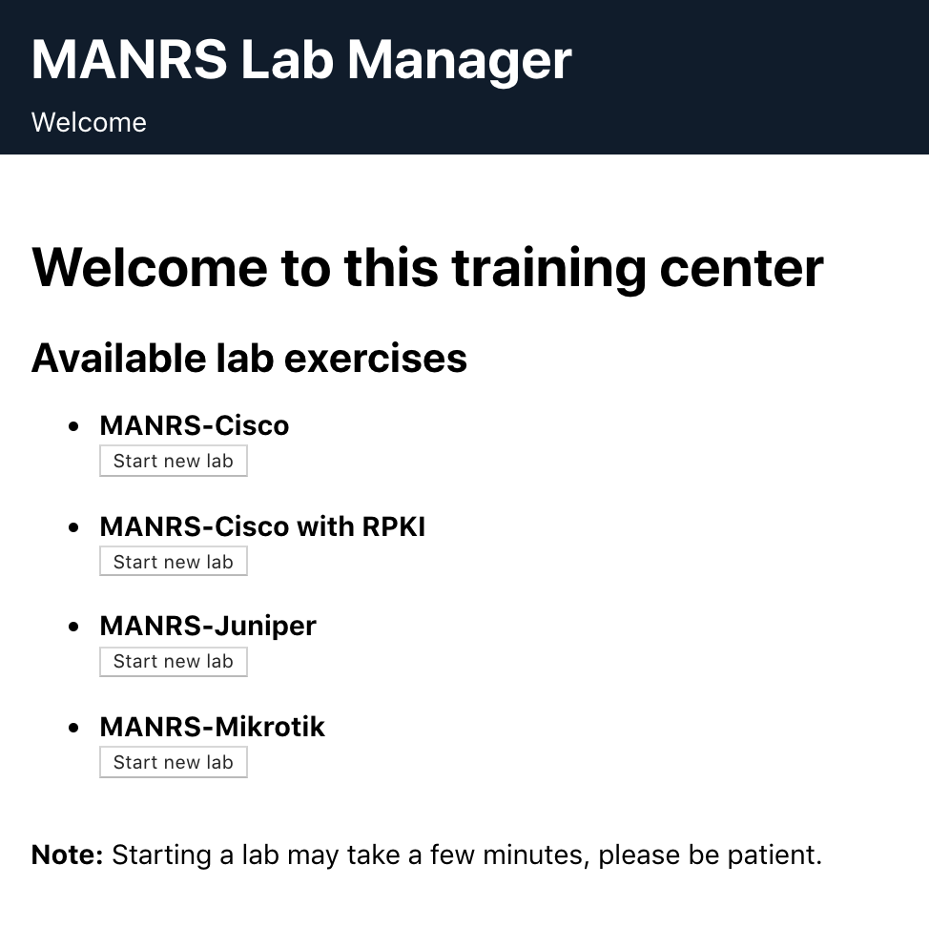
MANRS Online Training
To build skills on filtering, ISOC are developing an online lab that will allow network admins to test filtering techniques in a virtual environment
The lab currently supports the following routing platforms
Cisco
Juniper
Mikrotik

Slide 18
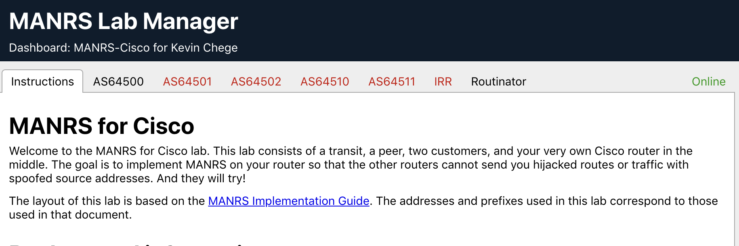
Each trainee will be provided with a topology of 5 routers, and an RPKI validator (RPKI). One of the 5 routers is configurable and the other 4 are sending traffic to it that needs to be filtered
The lab is due for completion in the coming weeks and will be made available to engineers globally. Information will be sent via regional tech mailing lists

Slide 19
MANRS Observatory - https://observatory.manrs.org/
Tool to impartially benchmark ASes to improve reputation and transparency
Provide factual state of security and resilience of Internet routing system over time
Allow MANRS participants to easily check for conformance
Collates publicly available data sources
BGPStream
CIDR Report
CAIDA Spoofer Database
RIPE Database / Whois
PeeringDB
IRRs

Slide 20
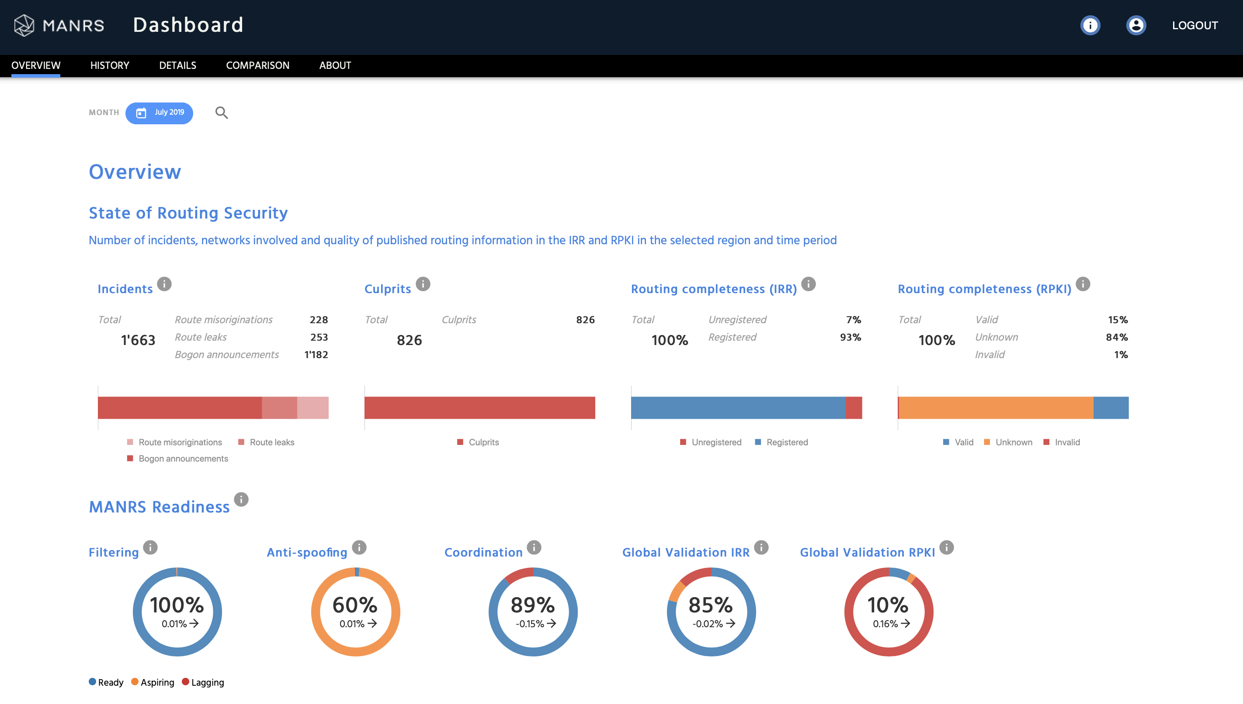
MANRS Observatory

Slide 21
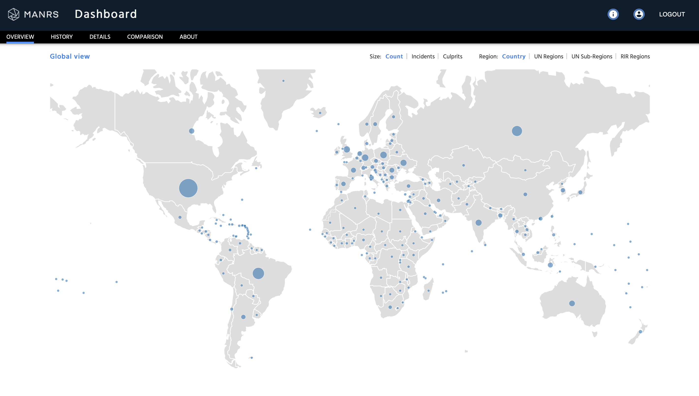
MANRS Observatory

Slide 22
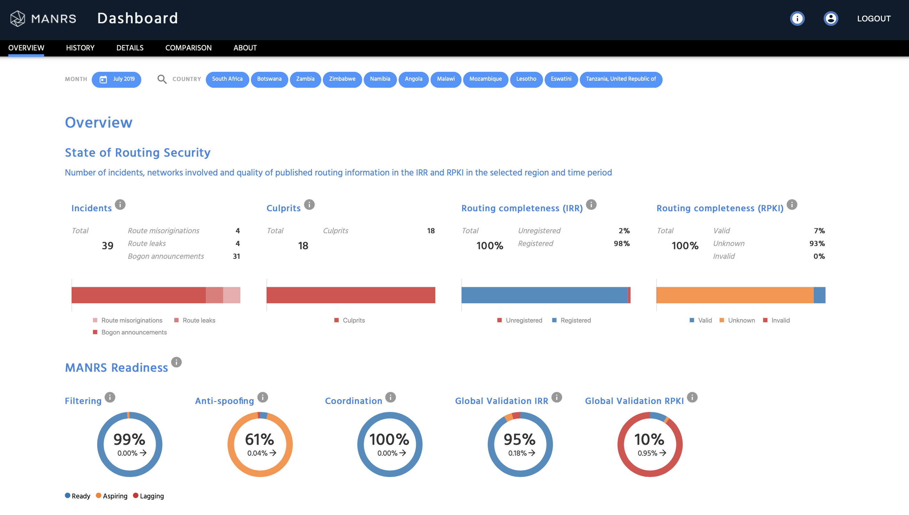
MANRS Observatory

Slide 23
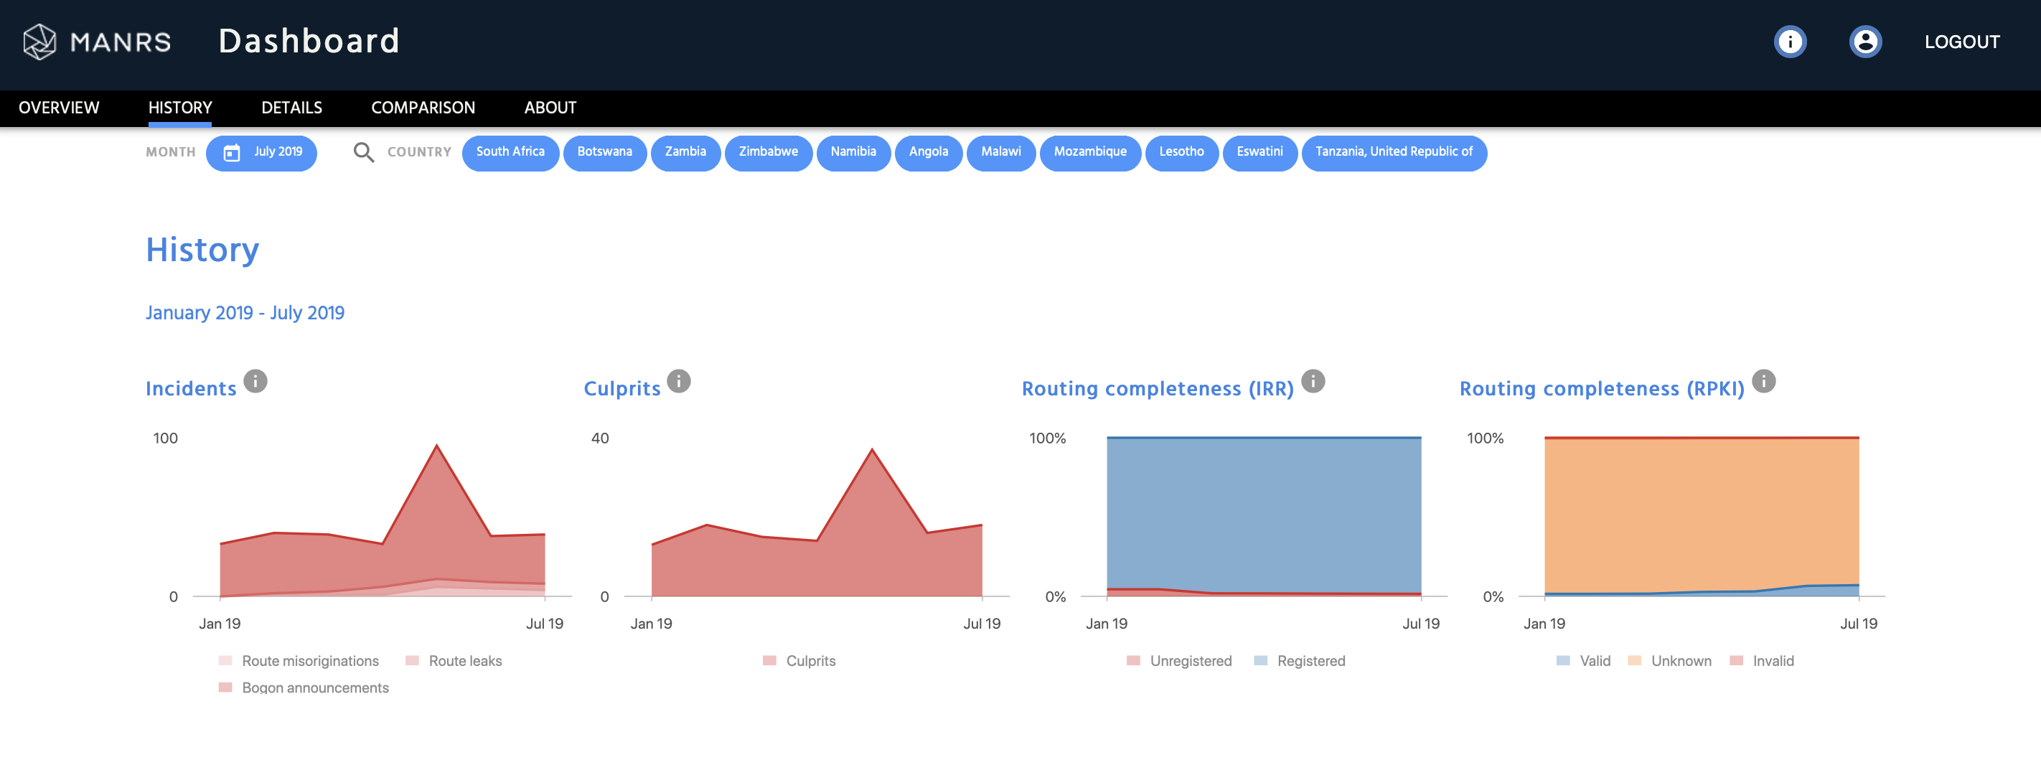
MANRS Observatory

Slide 24
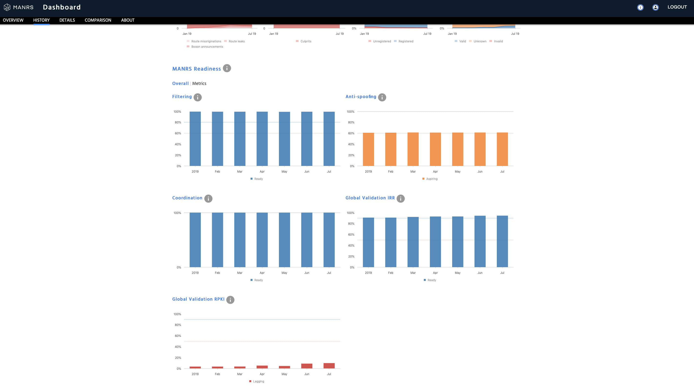
MANRS Observatory

Slide 25
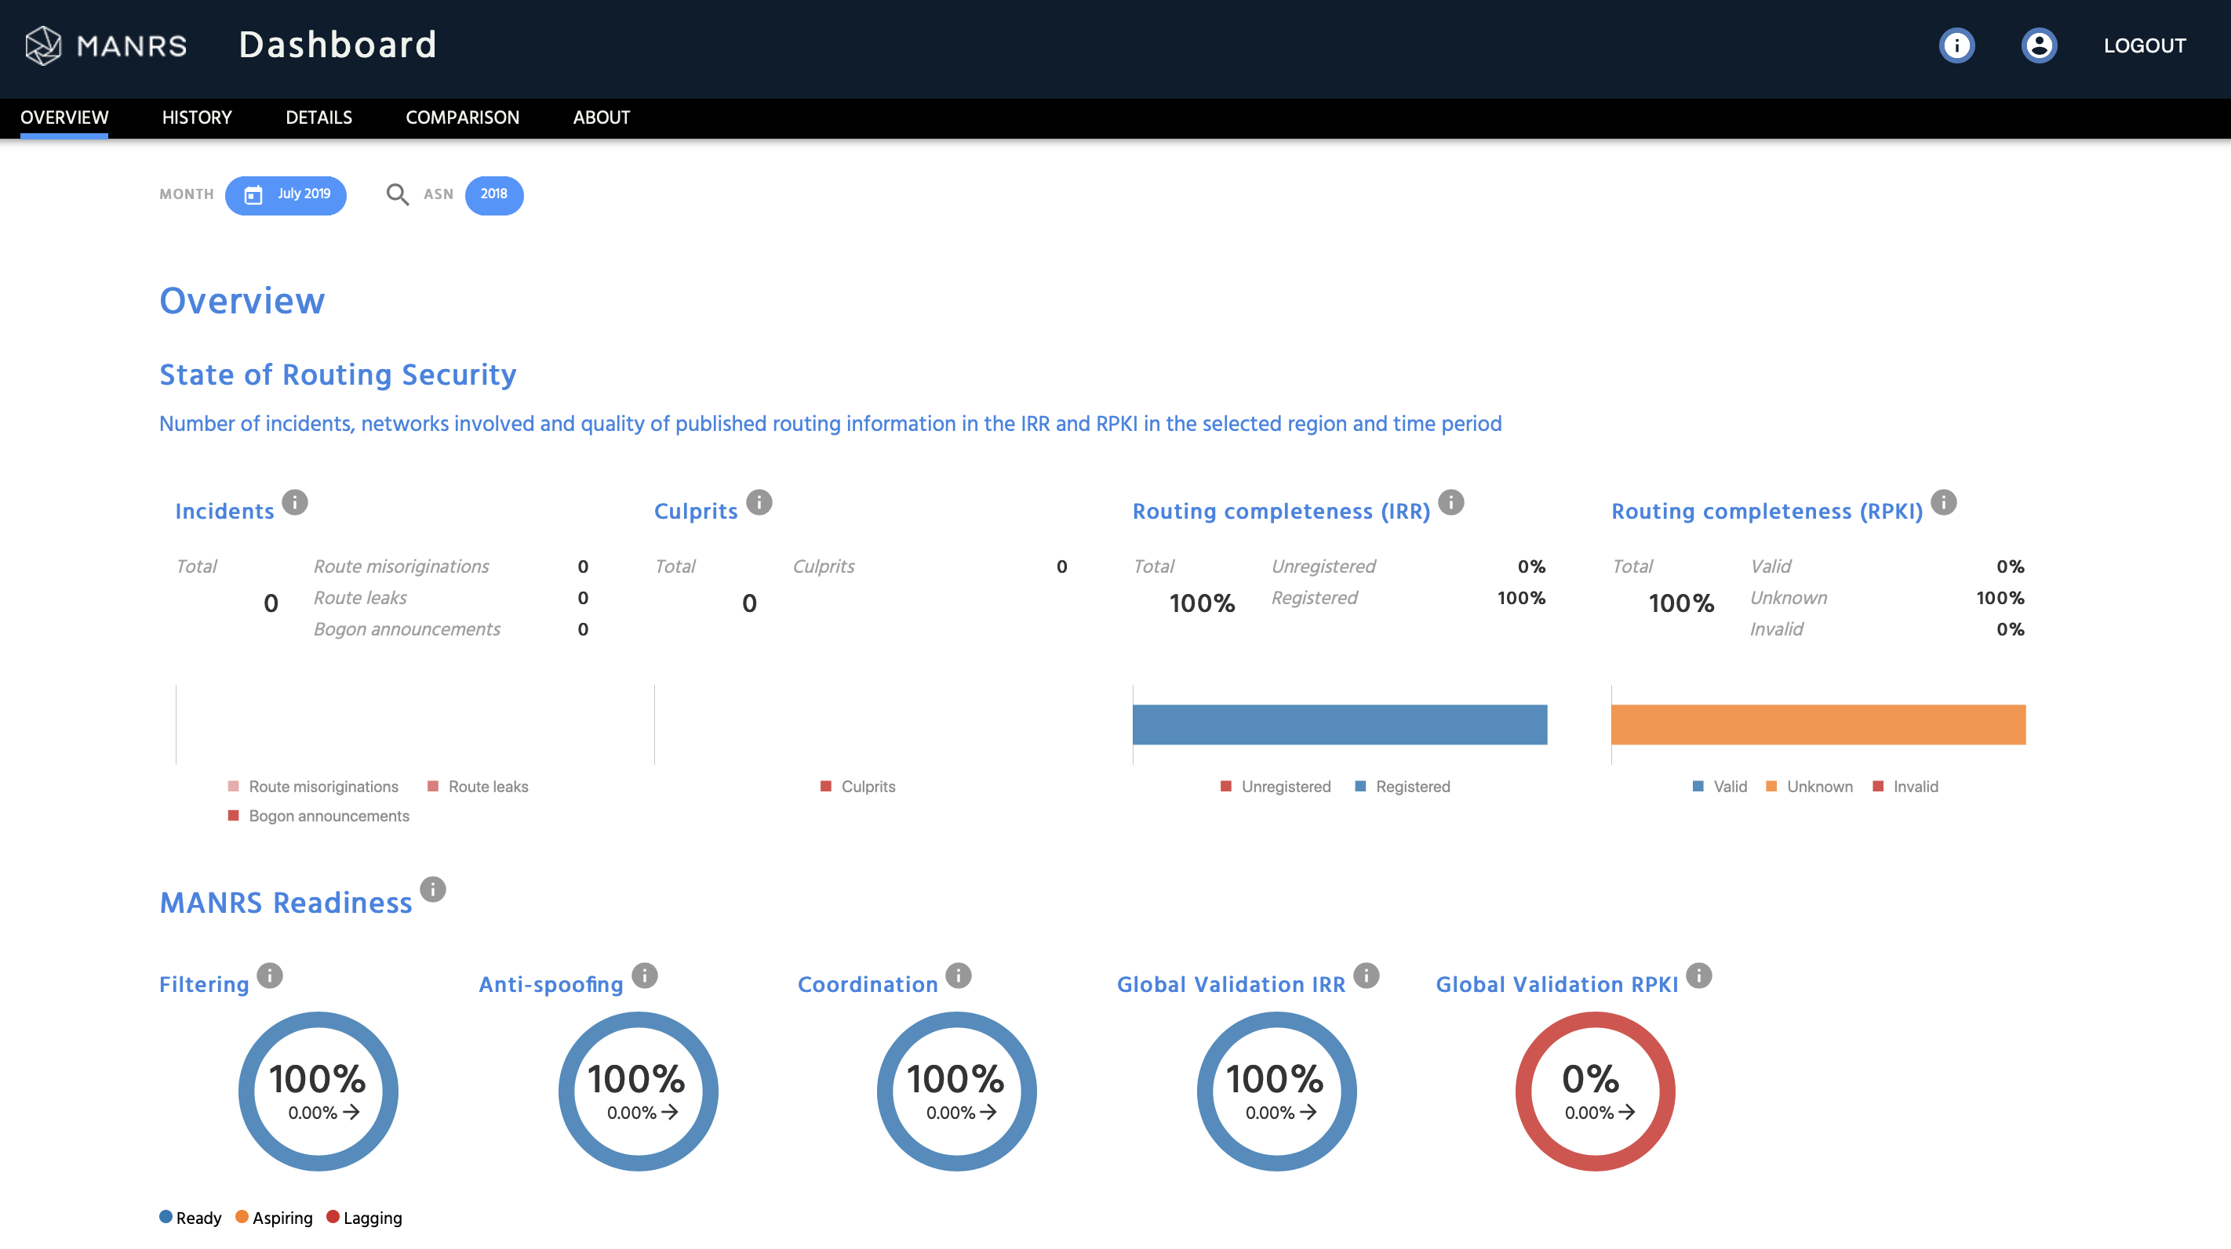
MANRS Observatory

Slide 26
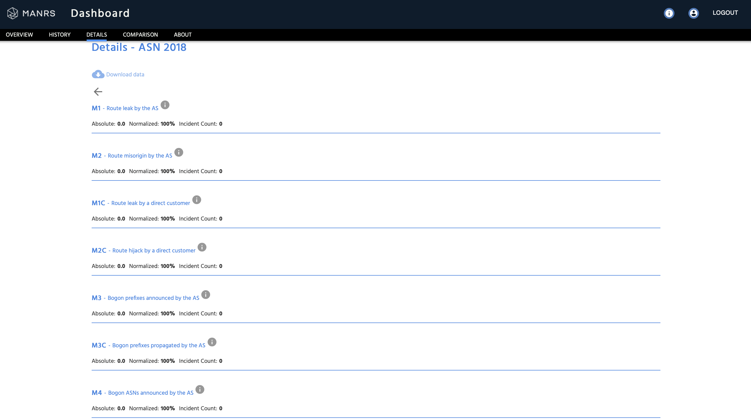
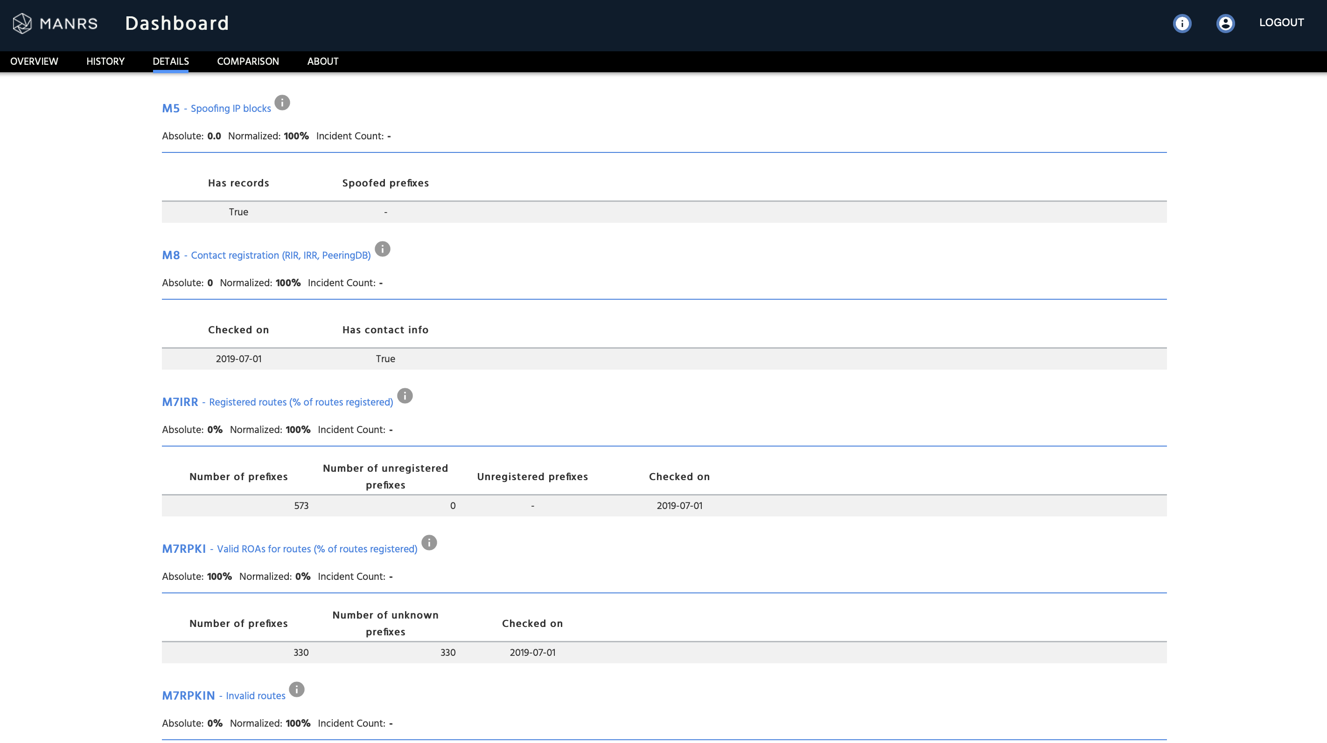
MANRS Observatory

Slide 27
MANRS Observatory Access
Launched on 13th August 2019 -
Current access policy:
Public will be able to view Overall, Regional and Nationally aggregated data
Only MANRS Participants will have access to detailed data about their network
Caveats:
Still some false positives
There are sometimes good reasons for non-100% conformancy
BUT, this is all inherently public data anyway!

Slide 28
MANRS IXP Programme
Action 1 Prevent propagation of incorrect routing information
This mandatory action requires IXPs to implement filtering of route announcements at the Route Server based on routing information data (IRR and/or RPKI).
Action 2 Promote MANRS to the IXP membership
IXPs joining MANRS are expected to provide encouragement or assistance for their members to implement MANRS actions.
Action 3 Protect the peering platform
This action requires that the IXP has a published policy of traffic not allowed on the peering fabric and performs filtering of such traffic.
Action 4 Facilitate global operational communication and coordination
The IXP facilitates communication among members by providing necessary mailing lists and member directories.
Action 5 Provide monitoring and debugging tools to the members.
The IXP provides a looking glass for its members.

Slide 29
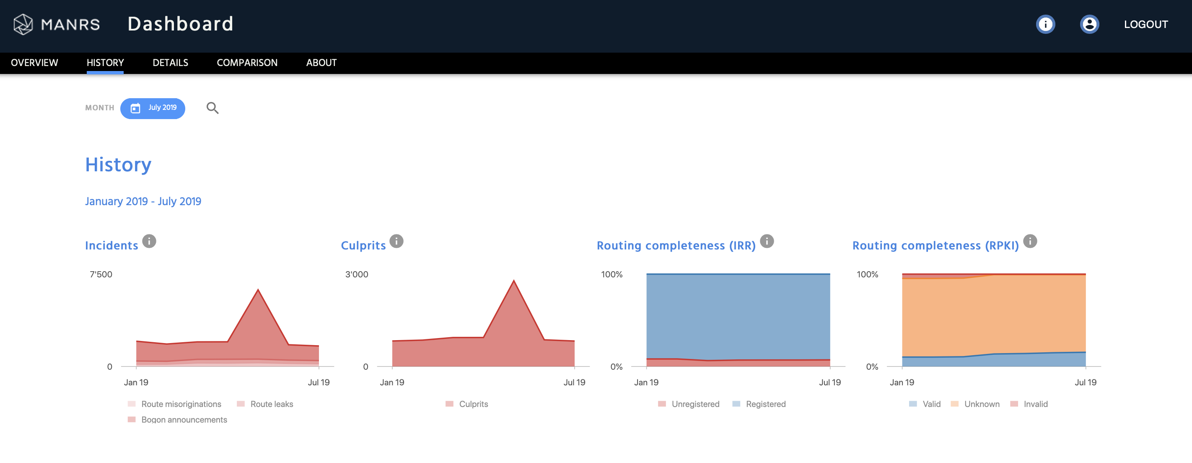
Is the problem getting better or worse?

Slide 30
MANRS Community

Slide 31
MANRS needs to be community driven
MANRS should be (and is) a collaborative initiative of Internet operators
Internet operators undertaking MANRS principles need to encourage use of best practices
MANRS needs to be driven by leaders within their communities who strongly believe that routing security is an essential component for the future well being of the Internet
Need feedback and recommendations for improving MANRS principles and best practices, e.g. MANRS Actions, MANRS Observatory, MANRS Implementation Guides, and training materials
Internet Society can help with presentations, informational materials and merchandise (shirts and stickers)

Slide 32

Join Us
Visit https://www.manrs.org
Fill out the sign up form with as much detail as possible.
Get Involved in the Community
Members support the initiative and implement the actions in their own networks
Members maintain and improve the manifesto and promote MANRS objectives

Slide 33
Michuki Mwangi
mwangi@isoc.org

